Slide 1

Maadi 505 – Smart Home Project
Anas Ayman
Youssef Salah
Ahmed Adel
AHMED KHEDR

Slide 2

Flowchart

Slide 3
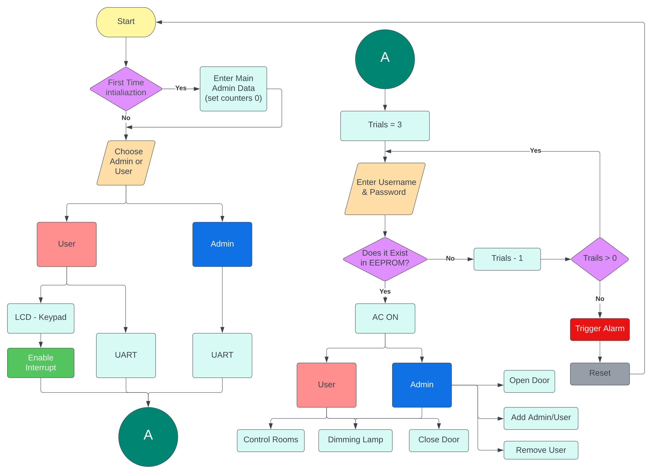

Slide 4

SCHEMATICS & CONNECTIONS

Slide 5
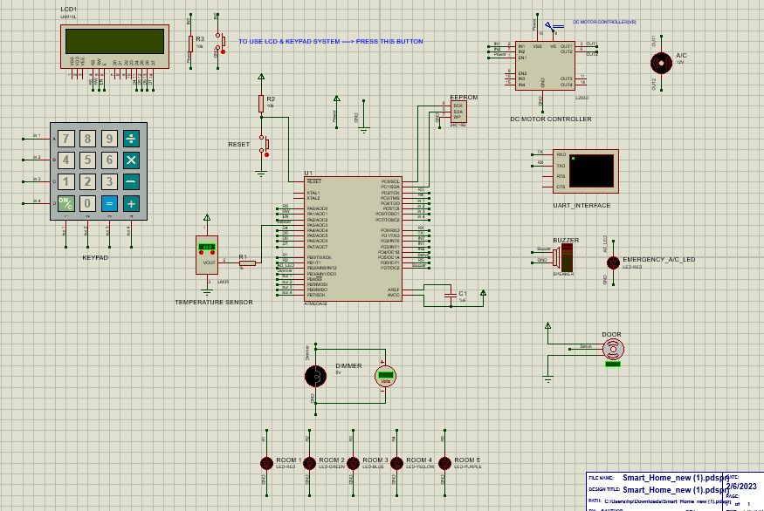

Slide 6

Peripherals Used
Peripherals Used:
ADC (Temperature sensor)
Timer (Door, Dimming lamp)
UART (Virtual Terminal)
LCD
Keypad
24C16 EEPROM
Interrupt (Transformation from UART to LCD)

Slide 7
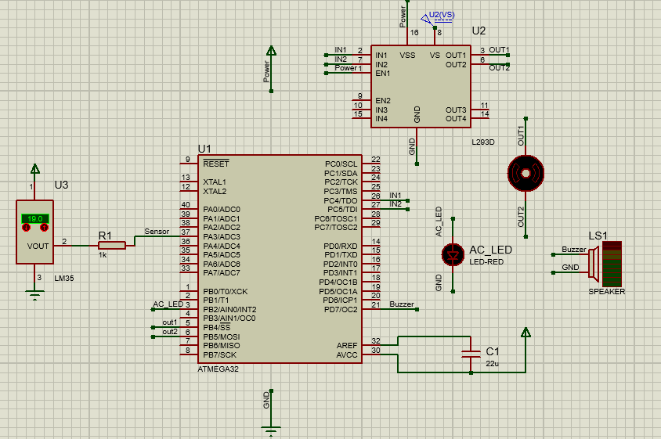
Temperature sensor and DC Motor
ADC to operate the temperature sensor (LM35)
Sensor Sensitivity
ADC resolution and V_{ref}
Working simultaneously with the system
RANGE OF OPERATION
(21°C, 28°C, 40°C)

Slide 8
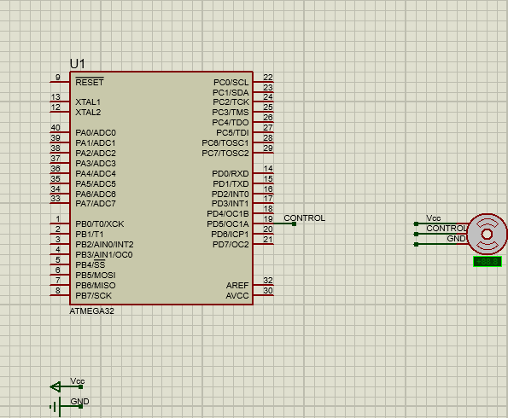
Servo Motor (Door Control)
To operate the servo motor, some preparations need to be done.
The operation of servo motor depends mainly on the concept of “Pulse Width Modulation” (PWM) which is controlled using TIMER peripheral.
Servo Motor used is SG90, which operates with 50Hz and different duty cycles depending on angle required.

Slide 9
Interrupt
From the requirements of the project is to have two interfaces, UART interface [admin/user] and LCD interface [user].
In order to switch between UART and LCD interfaces, an efficient method would be needed.
A solution was found, a push-button would be pushed whenever needed which triggers an external interrupt that switches to LCD mode/interface.

Slide 10

Lamps and Dimmer Circuit
5 Lamps in The Home
Dimmer lamp Brightness levels (0,25,50,75,100)%
Dimmer is a circuit that can control on the current flow to lamp depending on the input voltage “0 – 5V”.

Slide 11
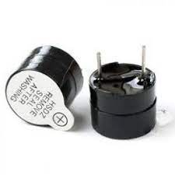
Alarm
Password Alarm
LAMPS TOGGLE
BUZZER
AC Alarm
AC LAMP IS ON
BUZZER

Slide 12
LCD & Keypad
LCD & Keypad specs
LCD Mode (4-bit / 8-bit)
Interfacing Mode (Admin/User).
When to use LCD & Keypad ?

Slide 13
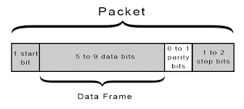
USART
USART is an abbreviation for Universal Synchronous Asynchronous Receiver Transmitter
UART protocol is used by admins/users to have an interface with the system
UART initialization (2-bit stop conditions / Asynchronous Mode)
UART BAUD RATE (9600)

Slide 14
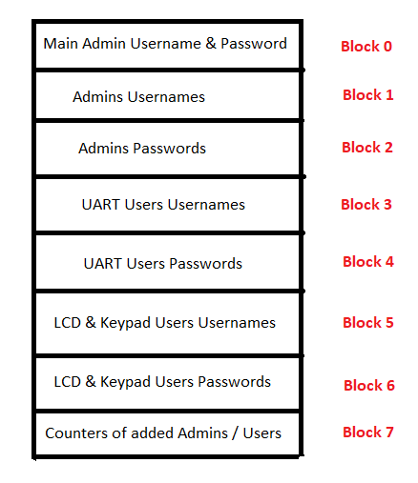
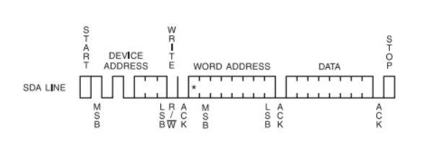
EEPROM
The used EEPROM is 24C16 which provides 2048 locations (2 KB)
EEPROM has 8 blocks, each block consists of 256 bytes numbered from 0 to 255
EEPROM operates with I2C Protocol
EEPROM BLOCKS ARE SUB-DIVIDED ACCORDING TO OUR APPLICATION WHICH CAN SERVE UP TO 64 ADMINS,REMOTE USERS, LCD USERS EACH.

Slide 15

SIMULATION Time

Slide 16
Thank You

